Slide 1
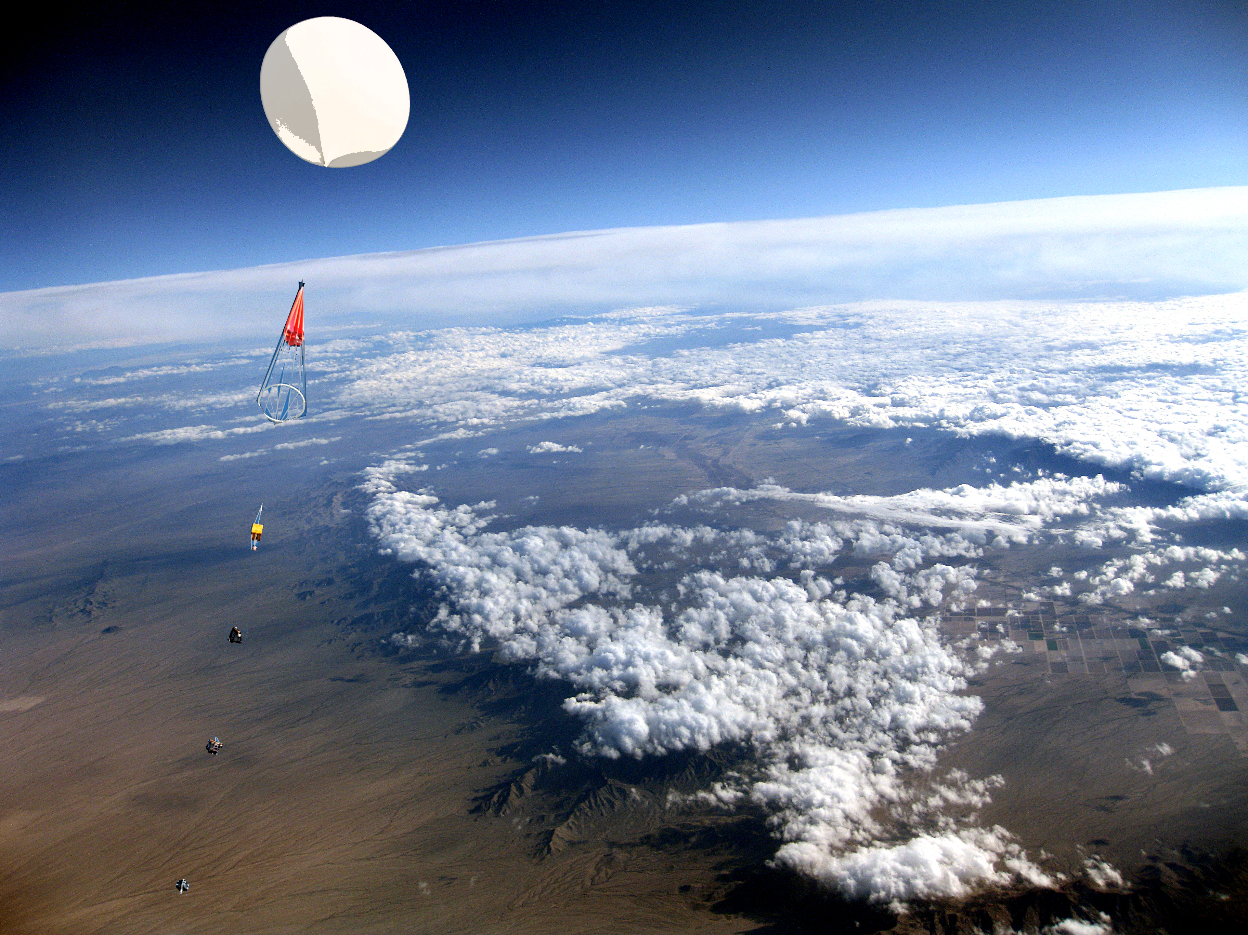



Balloon Stereographic Imaging System For High Altitudes
Pye Pye Zaw
Arizona State University

Slide 2
OVERVIEW
First launch camera system design, data and results
Second launch camera system design
Second launch data and results
Conclusion
An imaging system compose of two canon point and shoot cameras in a two off nadir configuration was designed to acquire stereographic panoramic images through anaglyphic stereoscopy techniques in high earth altitudes. The imaging system was flown on weather balloon flight, ASCEND!, during which images taken utilized the jet stream for horizontal velocity in shifting the images taken by the cameras on 3 second intervals to be paired. The two off nadir configuration allows for turbulence in flight and changes in horizontal velocity with the option to pair consecutive and 1 or 2 following shifted images. Image pairs were analyzed and processed with Adobe Photoshop to produce the final anaglyphic images which is tagged with altitude data from flight sensors.

Slide 3
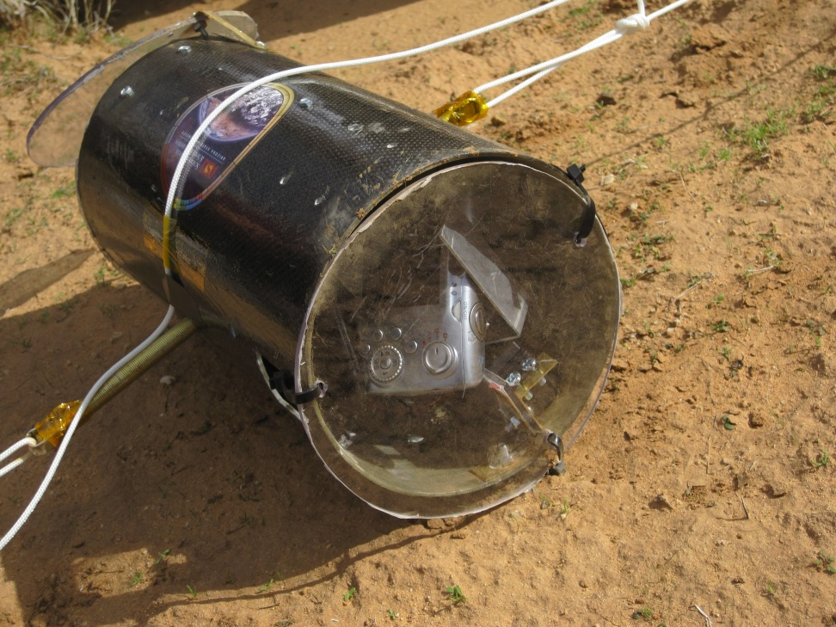
Launch #1
One digital point and shoot camera facing out, focusing and tracking on horizon
One infrared video recorder facing out
Images intended to be vertical panoramas
Resulted in horizontal panoramas due to jet stream
Video recording failed due to sensitive buttons

Slide 4
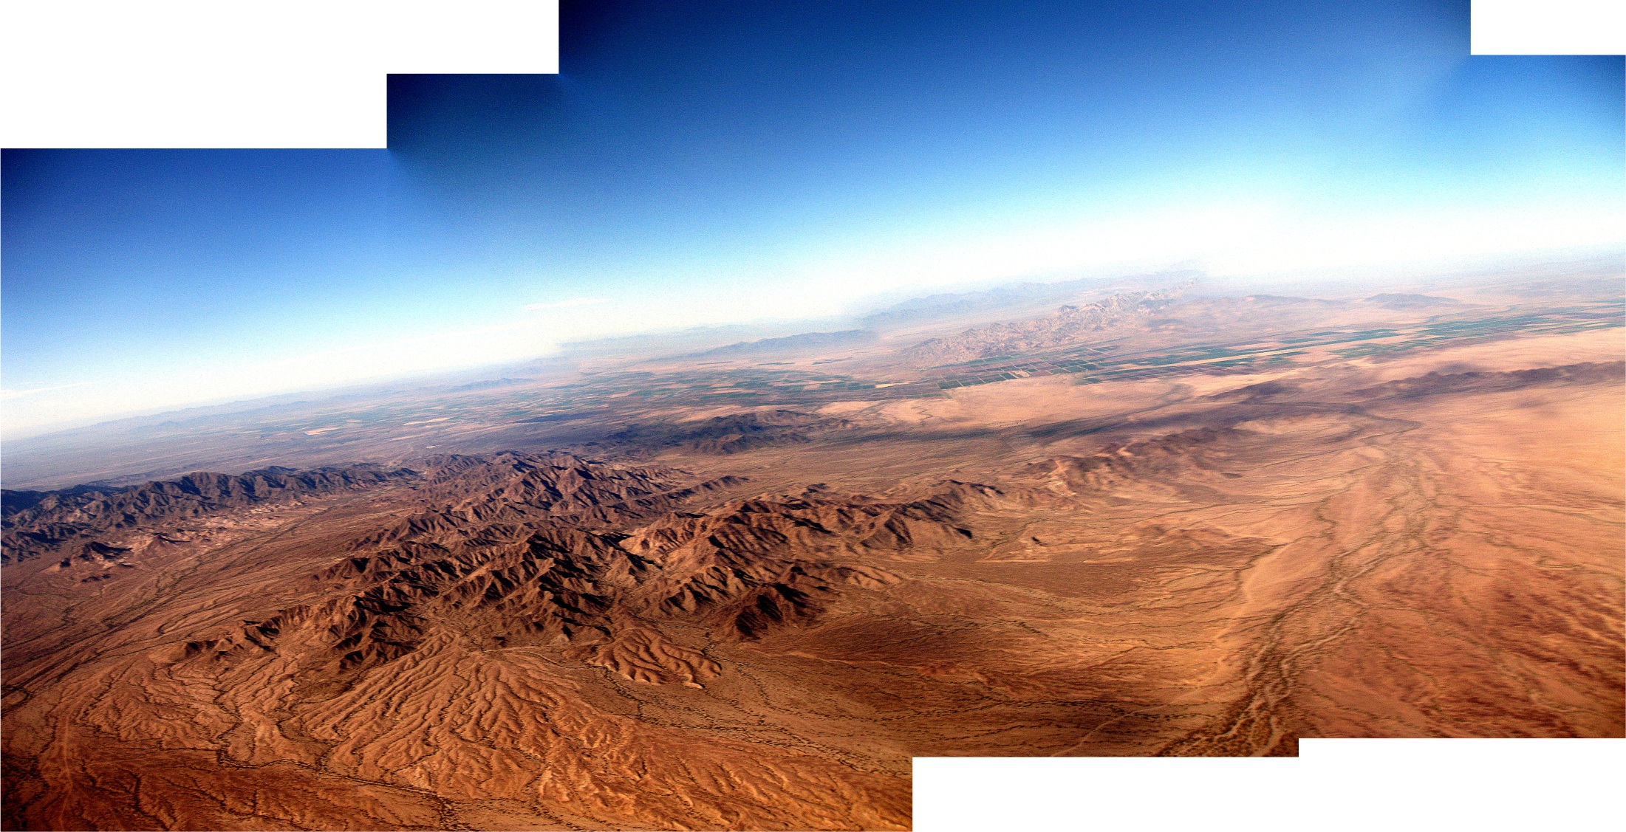

Slide 5
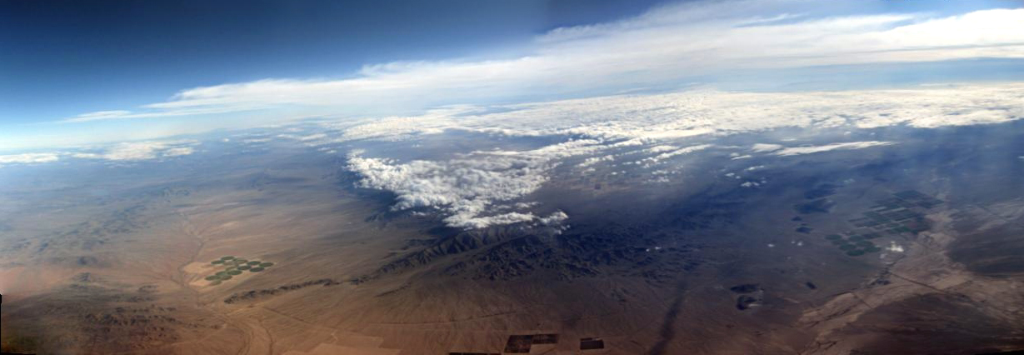

Slide 6
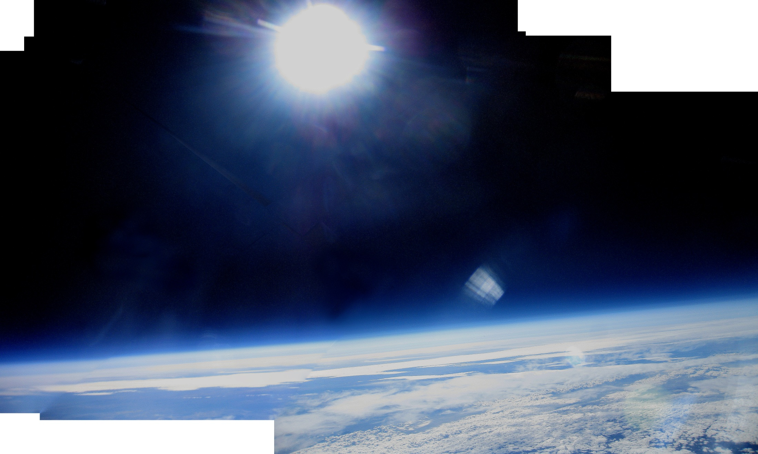

Slide 7
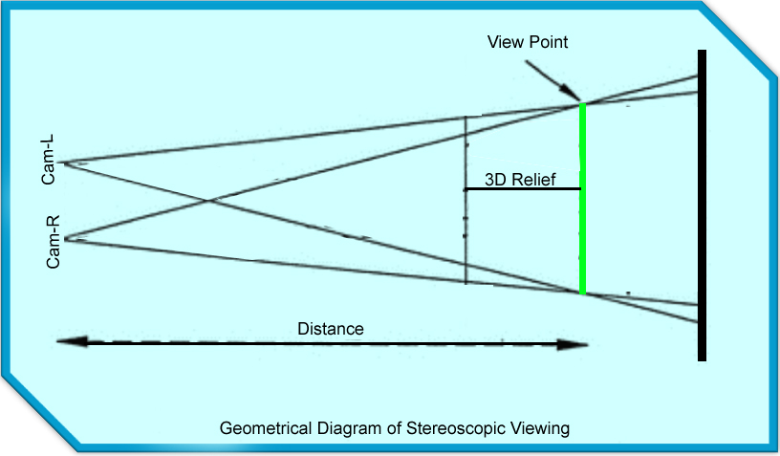

Launch #2 Camera System
Anaglyphic Images
Two Cannon point and shoot cameras controlled by Arduino Mini.
Two off nadir configuration
Utilizing jet stream for horizontal velocity to move camera for pair images
Tag altitude to each stereo image pair.

Slide 8
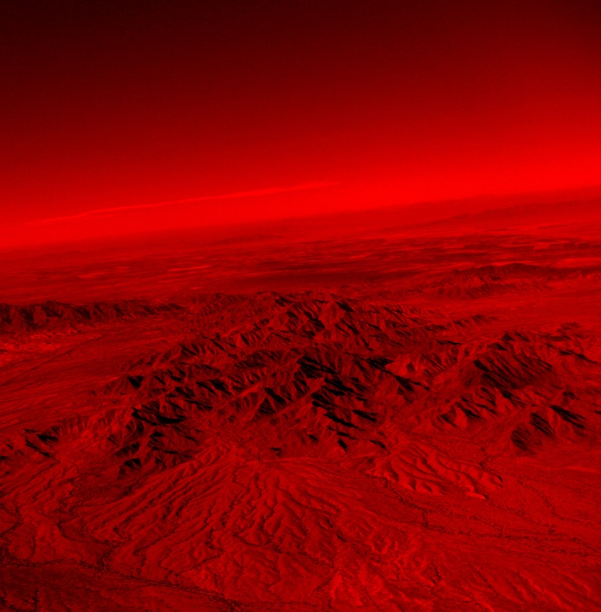
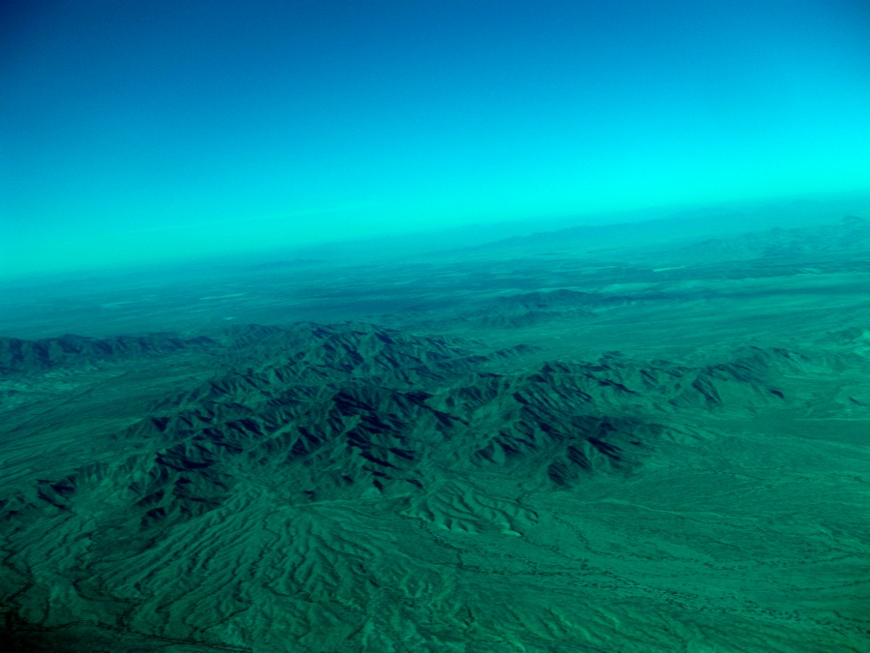
Image Technique Testing
Left Component
Right Component

Slide 9
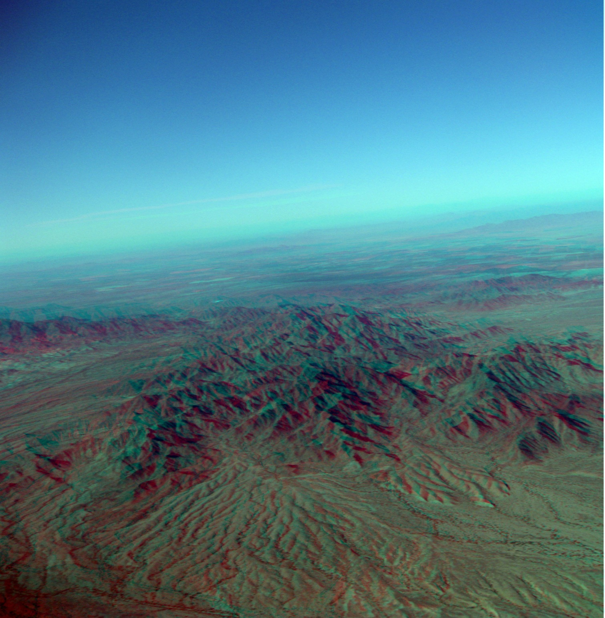

Slide 10
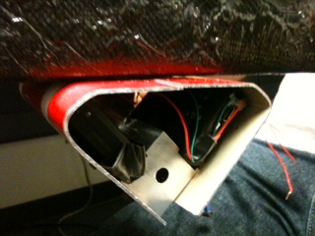
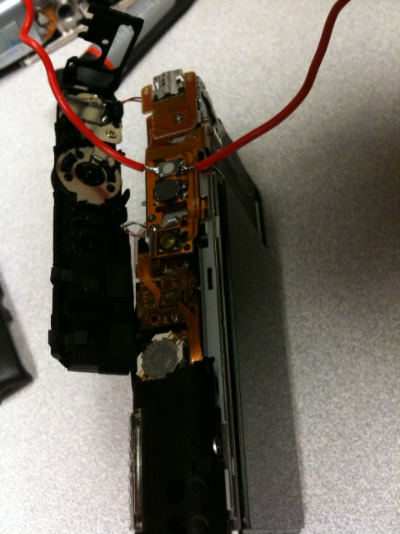
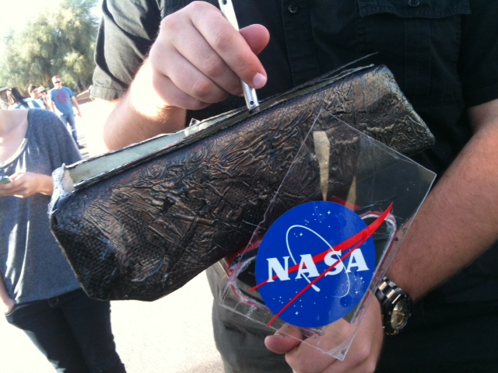
ASCEND! Spring 2012 Payload
Camera s
Completed Payload

Slide 11
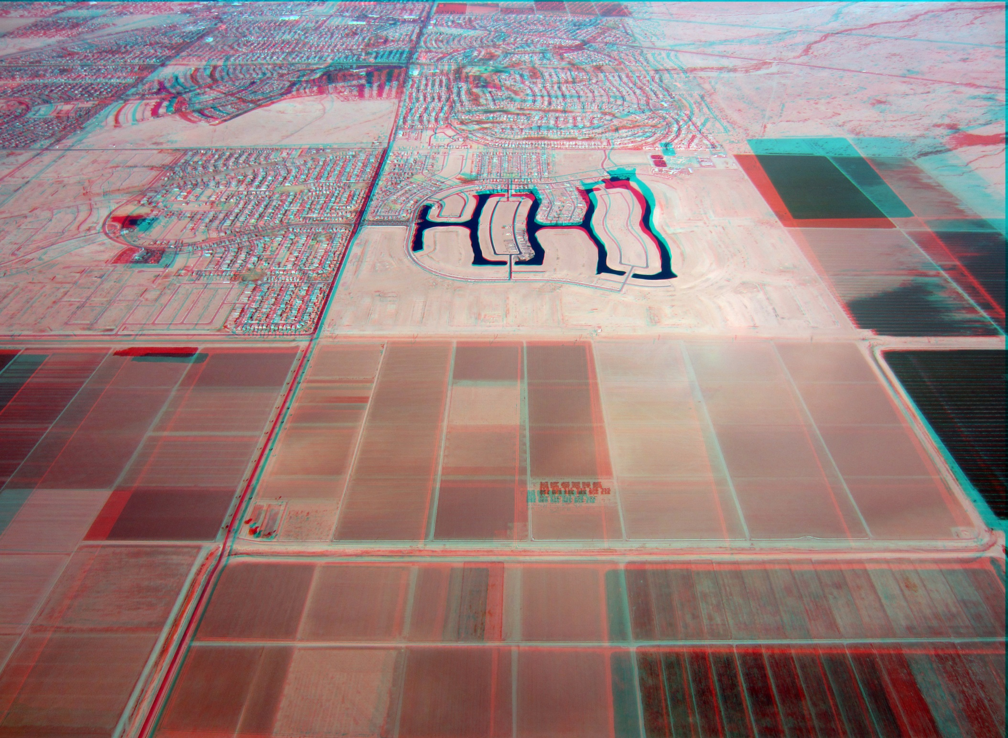

Slide 12
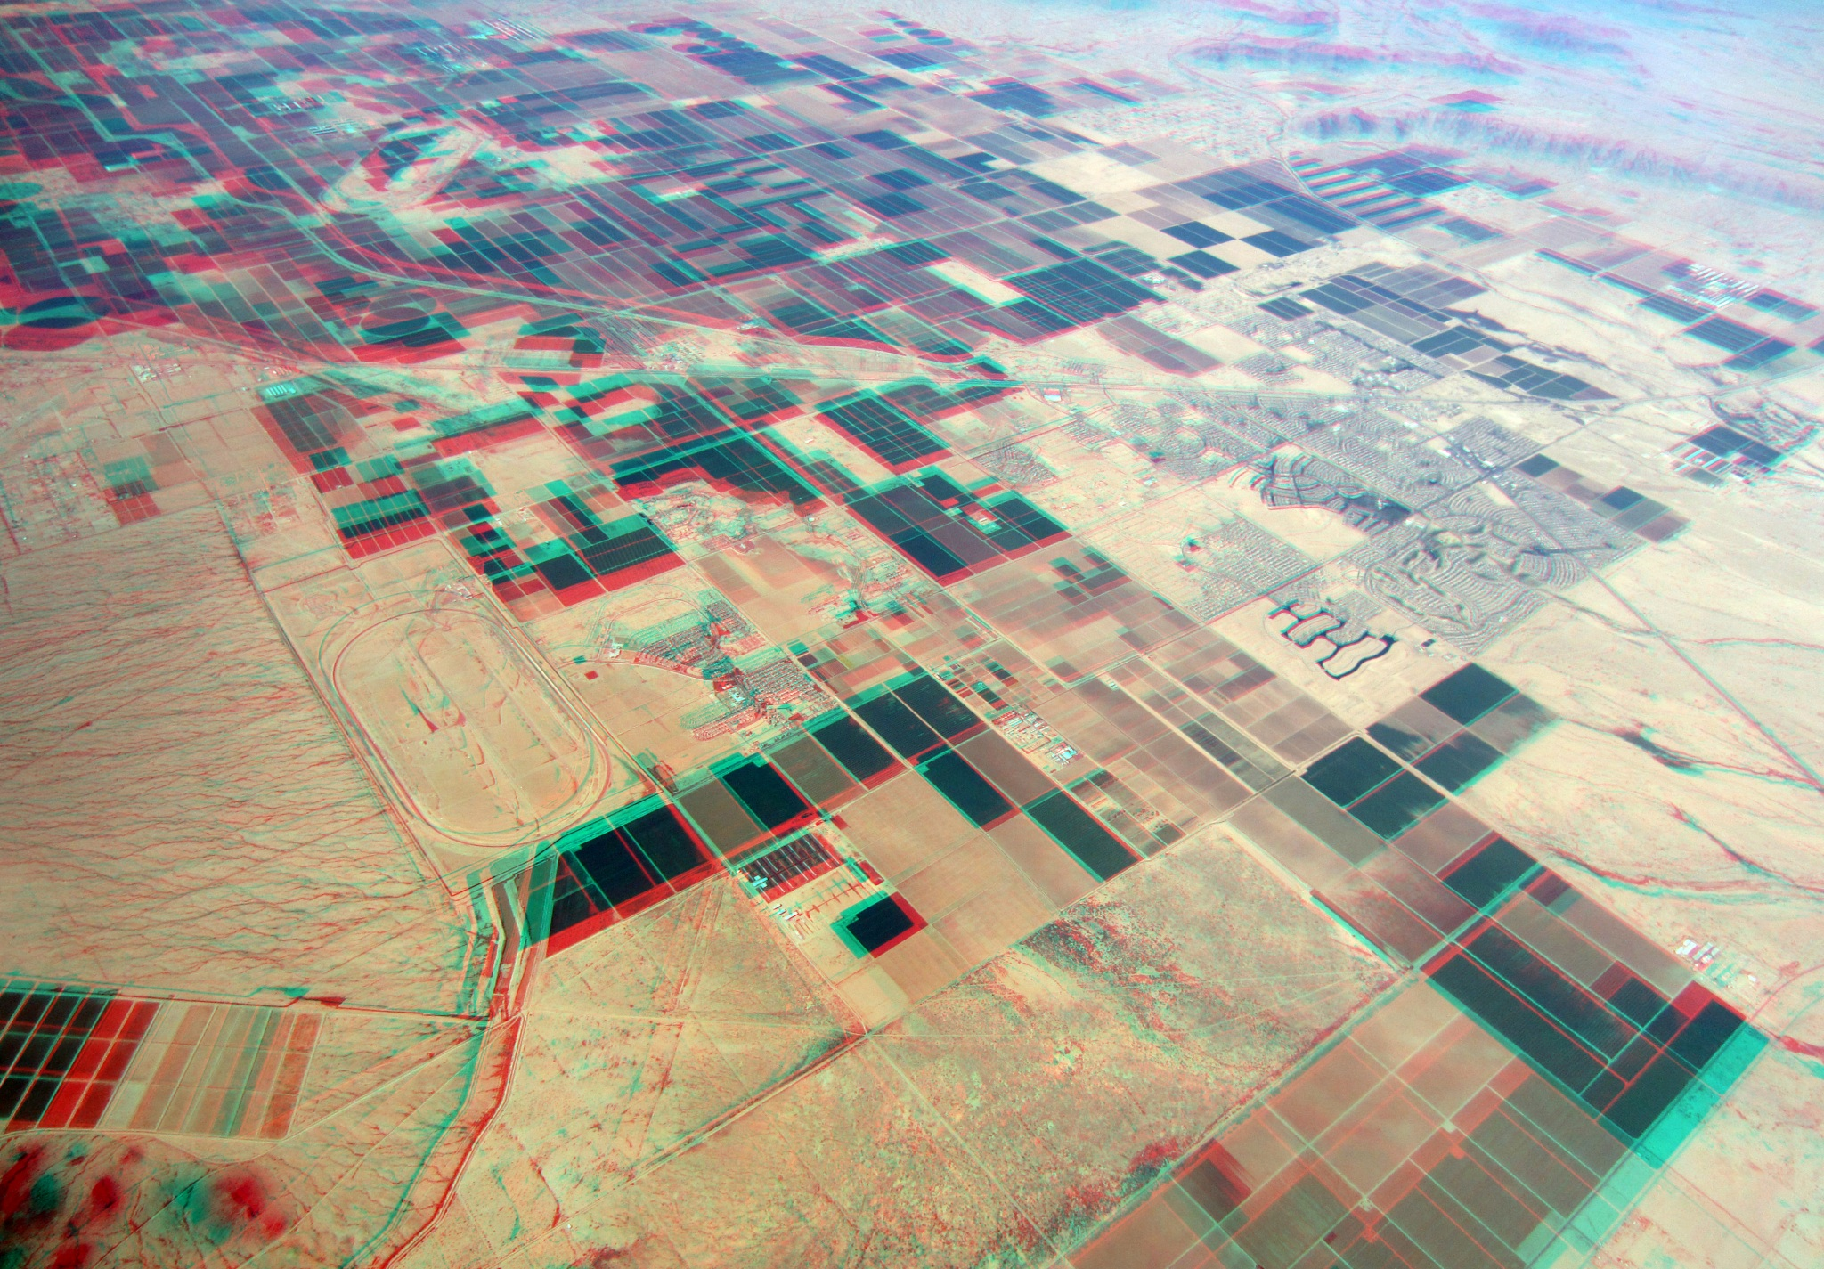

Slide 13
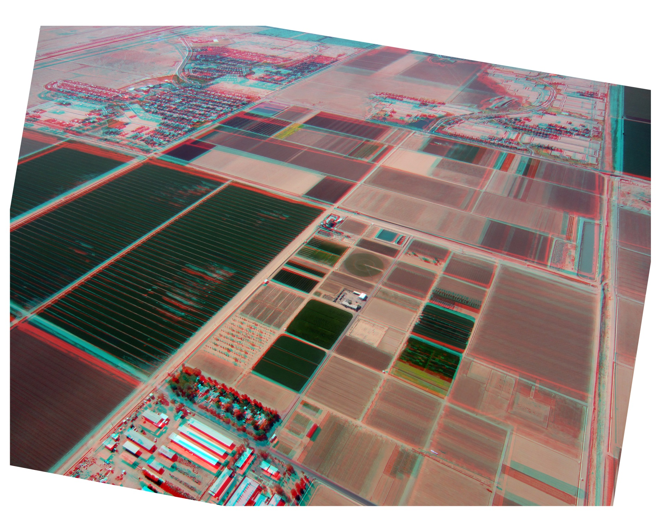

Slide 14
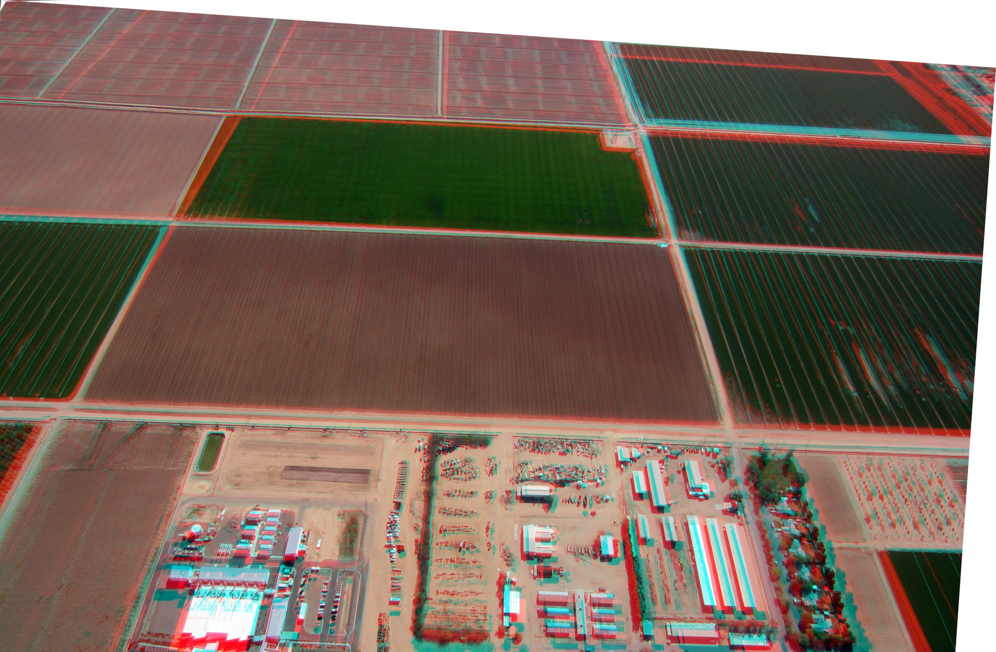

Slide 15
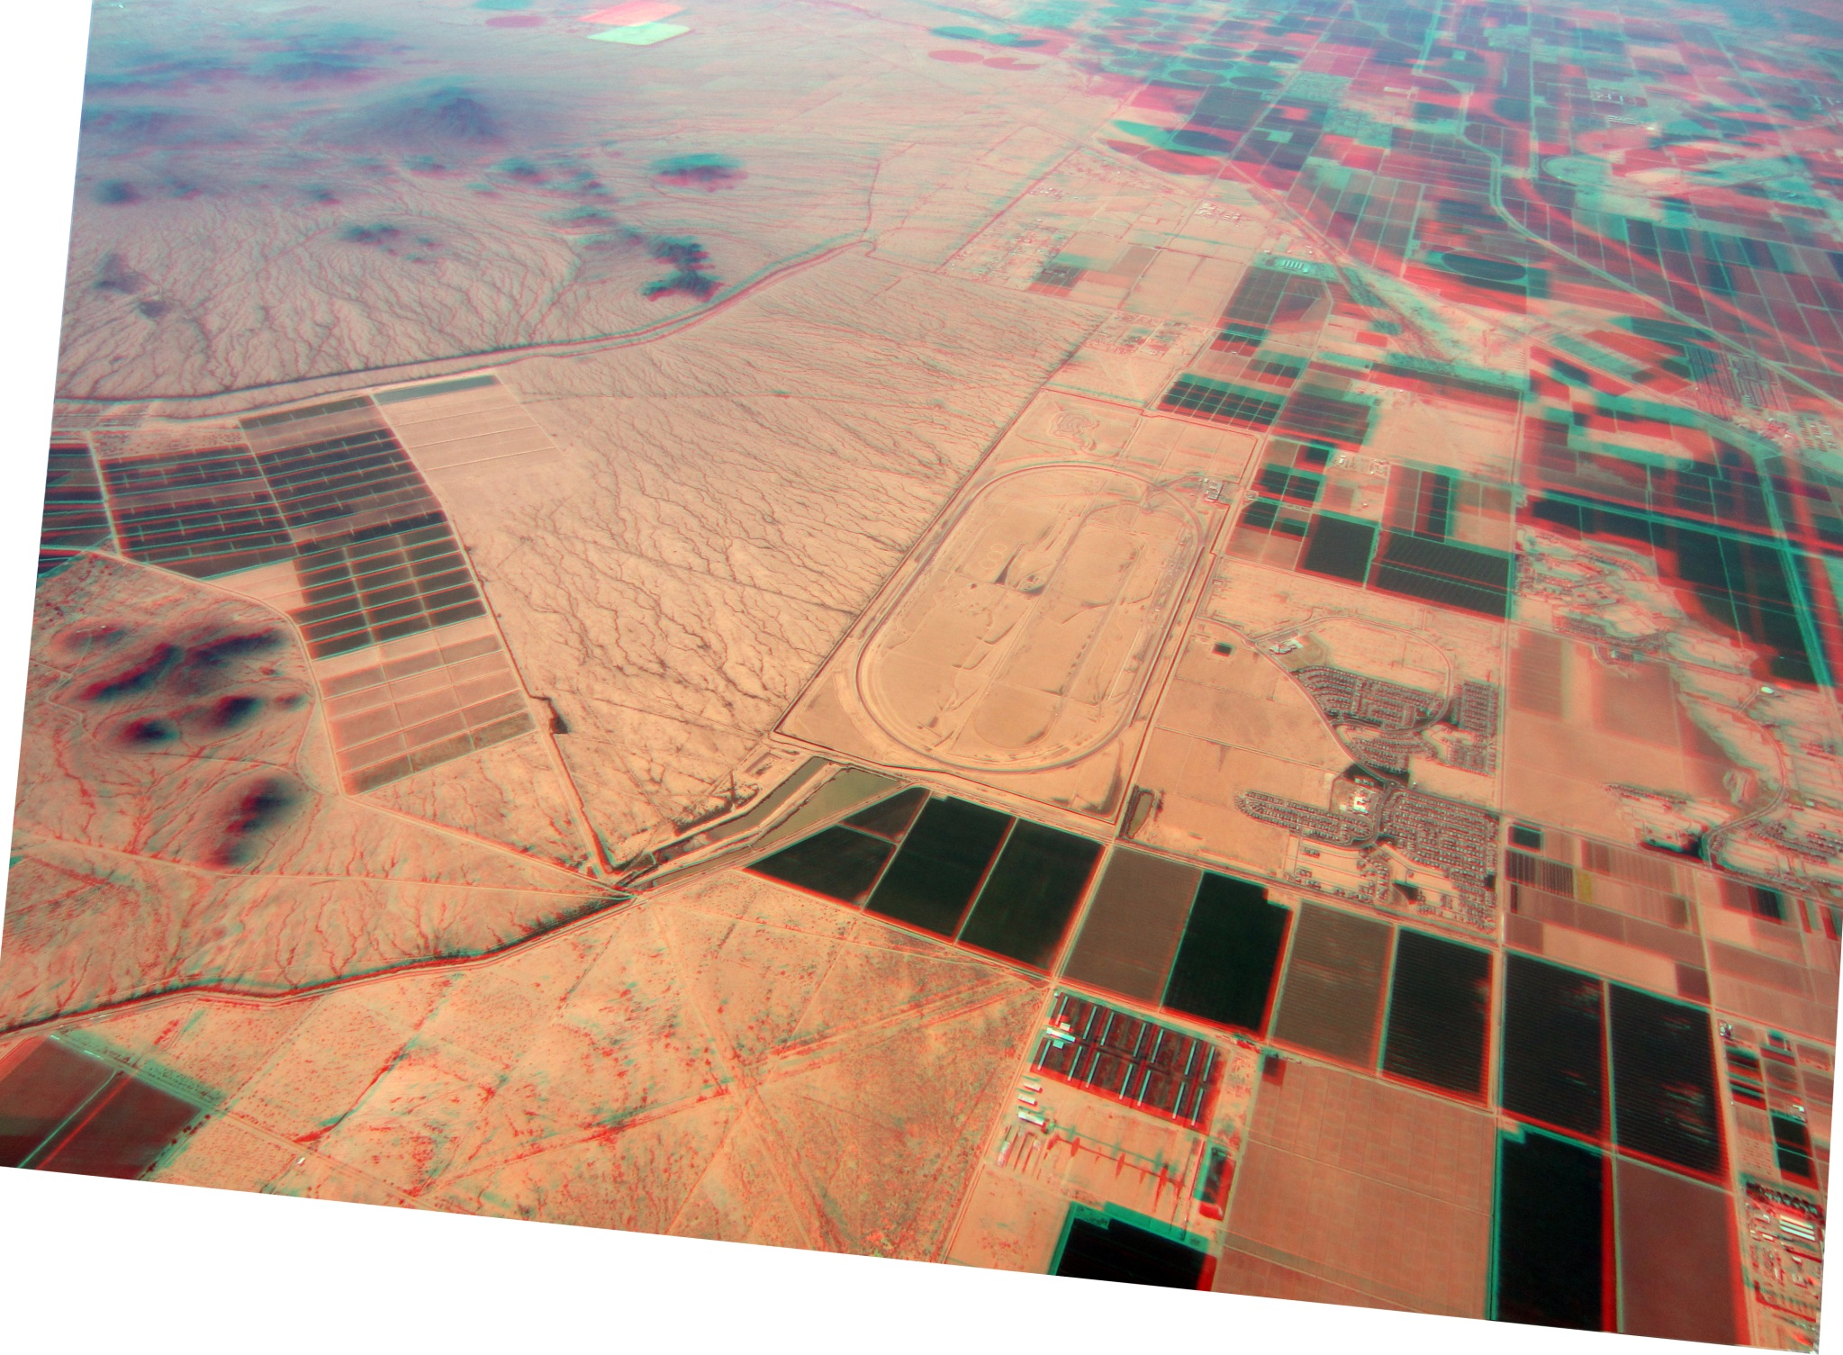

Slide 16
Conclusion
Two off nadir configuration allowed for turbulence and variations
Low altitude pairs have higher 3D relief
Data logger failed
Cameras shut off before descent
Consecutive images as well as 1 or 2 following the initial image were used to pair

Slide 17
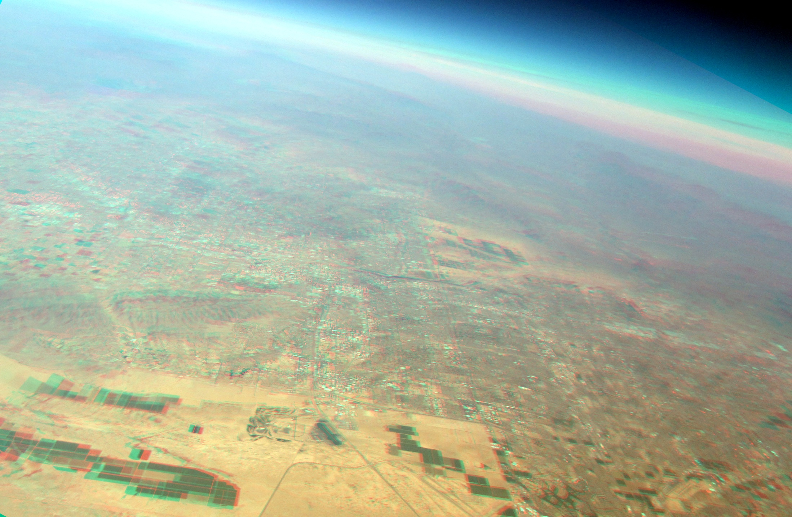
Questions?

